Slide 1
Predicting Volatility in US Electricity Prices
Miles Franklin, David Harper,
Adam Goldstein, Himanshu Ghritalhre

Slide 2
Importance
Electricity price volatility is important to understand
As the U.S. starts looking more into renewable energy, it is important to understand what impacts it could have
Understanding this volatility could help with a smooth transition into renewable energy sources
This understanding could also help with decision making for non-renewable energy sources
Decide on which parties to incentivize new adoption in where price volatility won’t be as effected. I.e Residential, Commercial, or Industrial customers.
Which states could feel the least impact from changes
Notes:
David

Slide 3
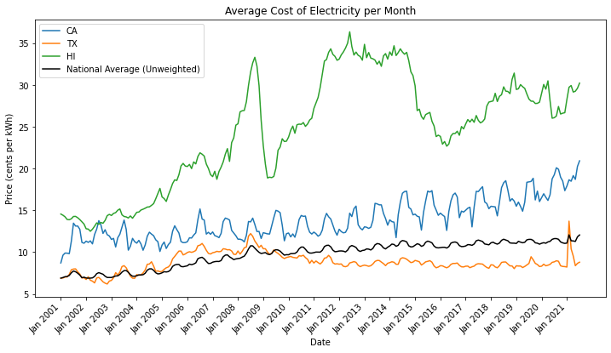
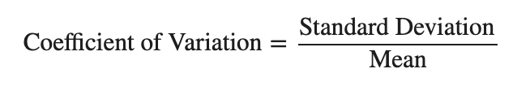
Overview
Target
The goal of this project is to produce a model predicting the price volatility of electricity for a given year. We measure the volatility using the Coefficient of Variation, to normalize the data and facilitate state to state comparisons.
Notes:
Features
Futures Market Volume
How well do market participants understand market direction?
Drought and Temperature Trends
Are the effects of climate patterns felt more by renewable sources?
Distribution of Fuel Sources in a State
What percent of production is from coal, solar, etc.?
Consumption measured in electricity sales
Do states that have more businesses and industry have a less stable price?

Slide 4




Data Sources (2001 - 2021)
Power Plants, Electricity Sales, and Electricity Accounts
US State Population Estimates
Future Contracts
Weather and Drought

Slide 5
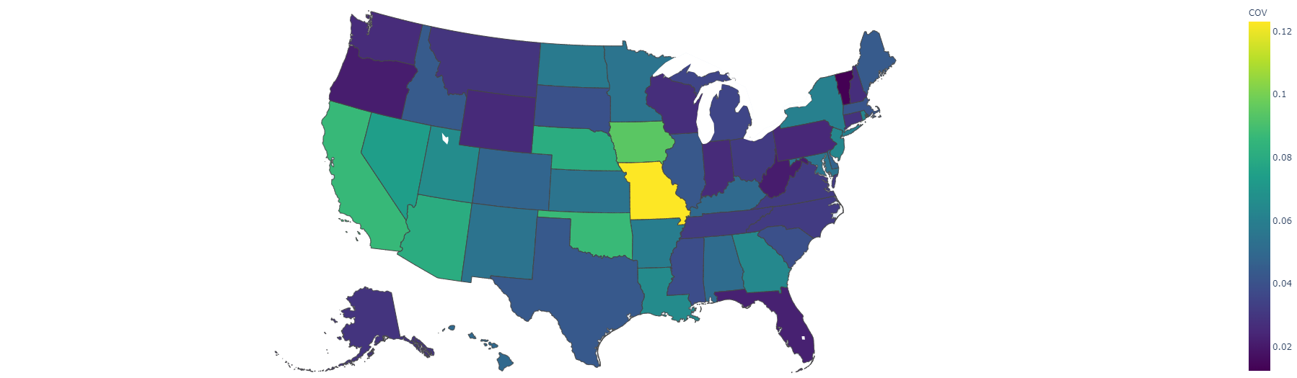
Exploratory Analysis
Average Coefficient of Variation by State
Notes:
David

Slide 6
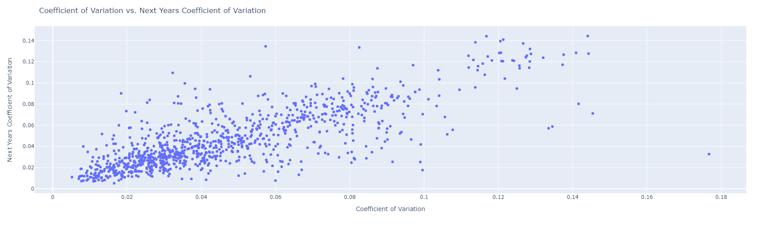
Exploratory Analysis
The most highly correlated variable with the coefficient of variation is the prior years coefficient of variation
Notes:
David

Slide 7

Modeling Pipeline
Feature Engineering
Model Selection
Model
Training
Log
Results
Compare
Models
Used aggregations and calculations to create new features with different information
Scaled numerical columns to fit with in [0,1]
All of our potential algorithms are organized cleanly into one place for quick access
Neptune AI
We compared Models using Adjusted R^2, a metric that shows the percent of variance explained by the model. While accounting for model complexity.

Slide 8
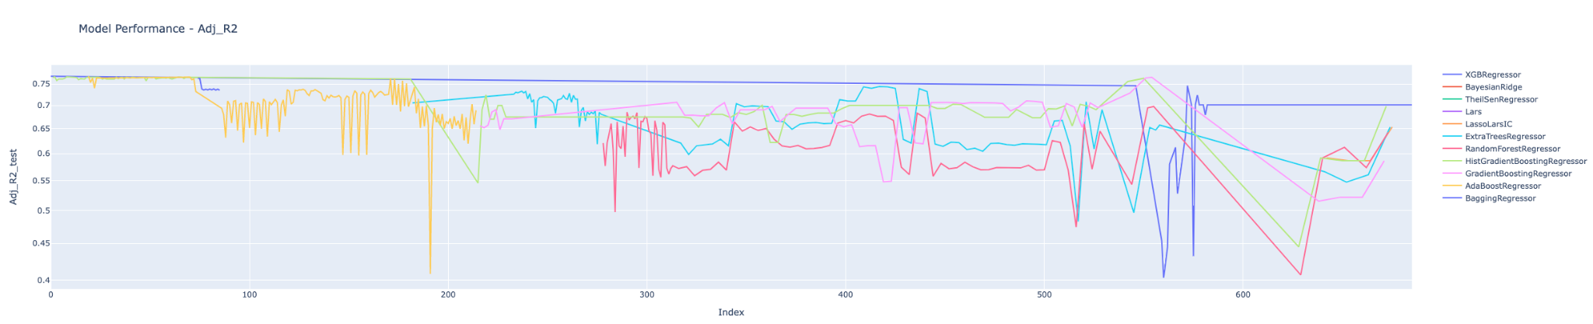
Neptune AI
Unique Experiments - 217
Feature Pipelines - 15
17 unique models
7 Ensemble
10 Linear

Slide 9
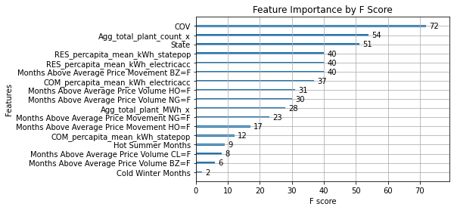
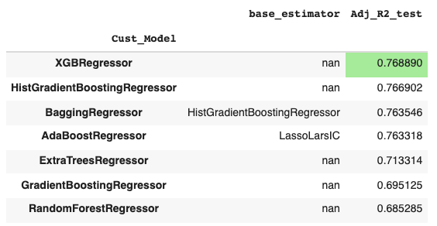
Final Model Choice
XGBoost Tree Model
Was able to account for the most variance in our data
(Adjusted R²=0.77)
Found that the most important features were:
The variance of the previous year
The total plant counts
The State of interest
Mostly metrics reflecting supply and demand of electricity

Slide 10
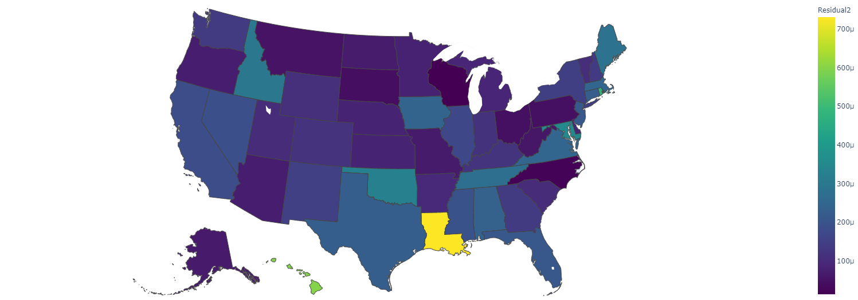
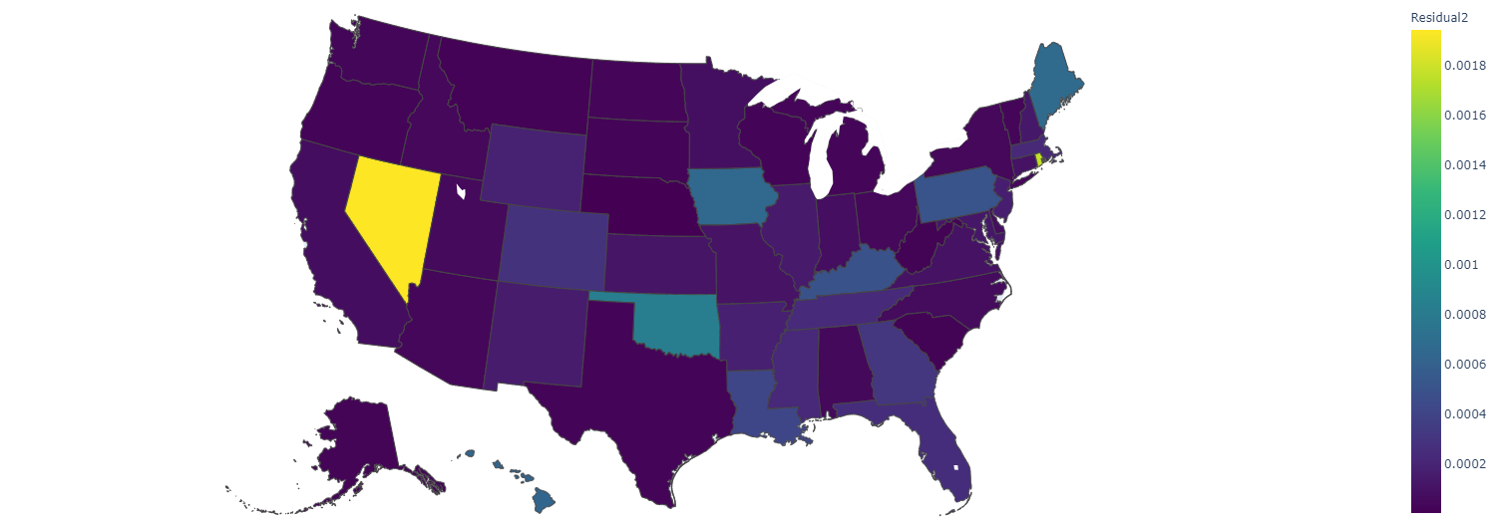
Model Performance by State
Training MSE by State Test MSE by State
Notes:
David

Slide 11
Future Directions
Different Data Sources
EIA was very a very helpful starting point, but was limited by the number of years it had records for
The model would likely benefit the most from just having more data to learn from
Feature Reduction
Many of our final models use all ~120 features
Feature reduction algorithms would help reduce the complexity of the models, and improve the performance without the need for new data
Transforming into a Classification Model
We began to explore classification models
Potential buckets for target variable
Basic increase or decrease in COV from previous year
Buckets of Low, Medium and High COV

Slide 12
Thank You!

